Slide 1

YouTube Performance Dashboard
Brahma Kumaris
Social Media Analytics | Power BI Case Study

Slide 2
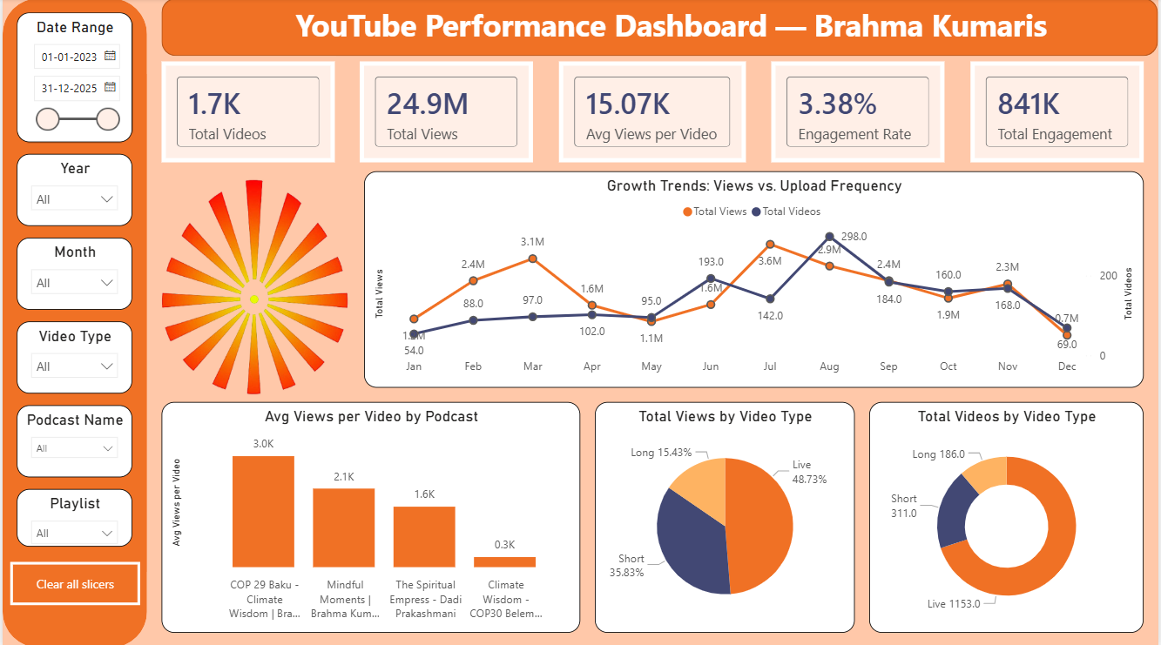

Slide 3

Key Insights from Dashboard
Overview :-
This dashboard provides an overall view of the Brahma Kumaris YouTube channel performance.It tracks content volume, views, engagement, growth trends, and video type performance.
KPI Cards (Top Summary)
Total Videos (1.7K): The channel has a large and consistent content library.
Total Views (24.9M): Strong overall reach and audience consumption.
Avg Views per Video (15K): Indicates stable average performance per upload.
Engagement Rate (3.38%): Healthy engagement for long-form spiritual content.
Total Engagement (841K): Audience actively likes and comments on content.

Slide 4
Key Insights from Dashboard
Growth Trend: Views vs Upload Frequency:
Upload frequency does not always guarantee higher views.
Certain months show high views with fewer uploads, indicating content quality matters more than quantity.
Avg Views per Video by Podcast:
COP 29 & Mindfulness-related podcasts receive higher average views.
Short spiritual theme podcasts perform better than general climate content.
Total Views by Video Type:
Live videos generate the highest total views, showing strong interest in live spiritual sessions.
Shorts contribute significant views, proving short-form content is effective.
Long videos have lower total views but provide depth and loyal engagement.
Total Videos by Video Type:
Live videos form the largest portion of uploaded content.
Shorts are used frequently for reach and awareness.
Long videos are fewer but serve as core knowledge content.

Slide 5
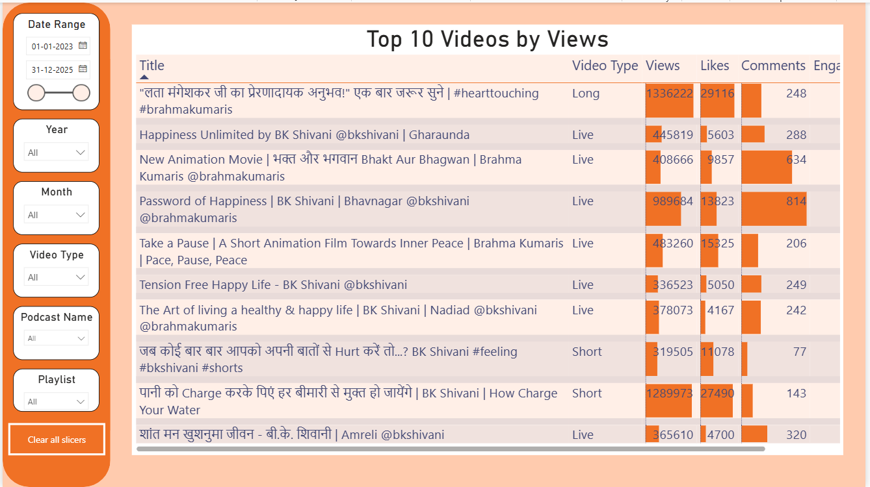

Slide 6
Table Dashboard Insights (Top 10 Videos)
Views Insight:
The highest viewed video crosses 1.3M+ views, showing strong viral potential.
Spiritual and motivational titles consistently rank in top positions.
Likes Insight:
Videos with emotional and practical life guidance receive higher likes, showing strong audience connection.
Like counts increase significantly for short and live formats.
Comments Insight:
Videos addressing personal challenges and peace of mind receive more comments.
Indicates deeper audience engagement beyond passive viewing.
Engagement Insight:
Shorts have higher engagement per view, even with lower duration.
Live videos maintain steady engagement over long durations.
Video Type Insight:
Live and Short videos dominate the Top 10 list.
Long videos appear less frequently but still attract loyal viewers.

Slide 7
Table Dashboard Insights (Top 10 Videos)
Views Insight:
The highest viewed video crosses 1.3M+ views, showing strong viral potential.
Spiritual and motivational titles consistently rank in top positions.
Likes Insight:
Videos with emotional and practical life guidance receive higher likes, showing strong audience connection.
Like counts increase significantly for short and live formats.
Comments Insight:
Videos addressing personal challenges and peace of mind receive more comments.
Indicates deeper audience engagement beyond passive viewing.
Engagement Insight:
Shorts have higher engagement per view, even with lower duration.
Live videos maintain steady engagement over long durations.
Video Type Insight:
Live and Short videos dominate the Top 10 list.
Long videos appear less frequently but still attract loyal viewers.

Slide 8


YouTube Performance Dashboard
Brahma Kumaris
Video
Dashboard File

Slide 9


